Slide 1

Welcoming International Medical Graduates News to Scotland (WINS)
Feedback and why is it important?
Notes:
Written by Jennifer Craig (GP TPD NorthEast)

Slide 2

What this session will cover….
Why feedback is important?
What feedback can you expect during your training or practice?
Experiences of feedback….
Ingredients of good feedback
Why does culture matter?

Slide 3

Why feedback is important?

Slide 4
Good conversations, fairer feedback, GMC 2021
Doctors in training consider feedback as an important part of their development.
Feedback was considered more credible if it was timely, actionable and specific.
More meaningful if the personal and professional values of giver and receiver are aligned.
A reported reluctance from trainers to deliver critical feedback means that trainees can struggle to get constructive and honest feedback.
Participants described the considerable impact that negative feedback in particular could have in striking language: ‘public shaming’; ‘ambushed’.
An absence of feedback leaves trainees feeling uncertain, insecure, and disconnected.

Slide 5
Good conversations, fairer feedback, GMC 2021
Positive feedback made trainees feel engaged, built confidence, and influenced career choices.
Poorly delivered feedback was described as impacting on relationships, engagement within departments, affecting training opportunities, and reducing access to help and support.
Feedback was highlighted as a way that workplaces and trainers demonstrated interest and investment in trainees.
Cultural barriers were identified, especially by trainees with protected characteristics, as a reason they felt feedback was not relevant or appropriate.

Slide 6
What feedback can you expect during your training?
Informal verbal feedback
Work-Place Based Assessments (WPBA)
Written feedback - e-portfolio and MSF
ARCP panels and Professional Exams

Slide 7

Experiences of feedback….
Our first feedback probably comes from our parents
How we think about feedback depends on experience, culture and education
Differences in what is expected can lead to misunderstandings

Slide 8
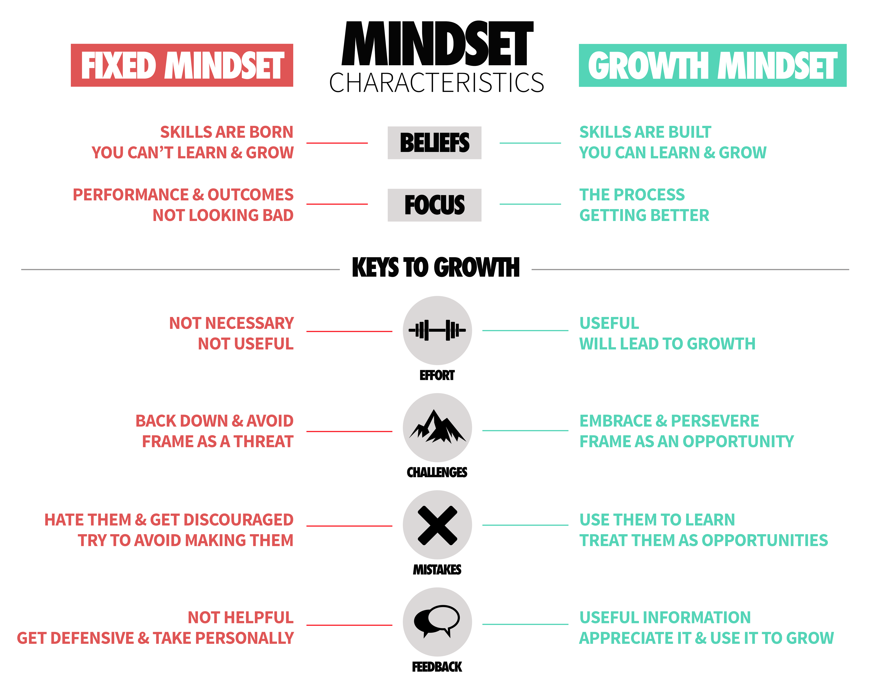

Slide 9
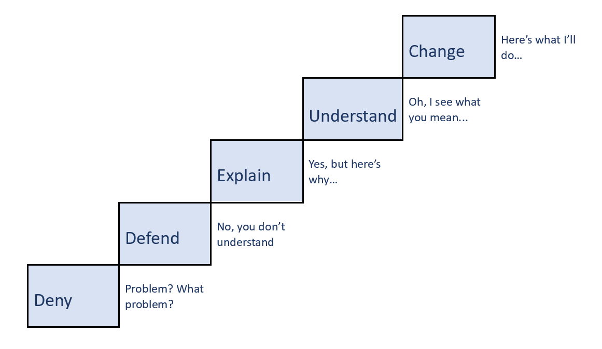
Feedback staircase

Slide 10

Ingredients of good feedback
Specific & Descriptive
Focused on Positive
Collaborative/Coaching
Timely
Caring
Checked for Understanding
Followed-up

Slide 11

Why does culture matter?

Slide 12
Consider differences in culture
Direct cultures use ‘upgraders’ that make it feel stronger, such as ‘absolutely’, ‘totally’, or ‘strongly’: “This is absolutely inappropriate,” or “This is totally unprofessional"
Indirect cultures use ‘downgraders’, such as ‘kind of’, ‘sort of’, ‘a little’, ‘a bit’, ‘maybe’, and ‘slightly’
A deliberate understatement is a type of downgrader, such as “We are not quite there yet” when you really mean: “This is nowhere close to complete”
And remember “Experiences of feedback…”
Notes:
Slide 12
Introduction of concepts of upgraders and down graders and how this might impact on both giving and receiving feedback
Remember to reflect back to experiences of feedback from the past, parents/families, school, University and how this might be different on different cultures
May wish to give an example “I used to have to tell my kids a thousand times to put their shoes on for school”

Slide 13
How best to provide Multi-Cultural feedback – for trainers and trainees!
Build relationships - Discuss views and experiences of feedback
Consider cultural differences and expectations
Seek out feedback yourself
Provide regular praise and constructive developmental feedback
Check if it is safe to give feedback

Slide 14
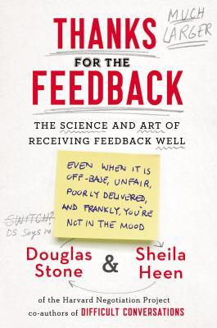
It doesn’t matter how much authority a feedback giver has, the receivers are in control of what they do and don’t let in, how they make sense of what they’re hearing, and whether they choose to change.
It’s about how to engage in feedback conversations with confidence and curiosity and find insights that might help us grow.

Slide 15

Thank you for listening
Any questions?

