Slide 1



GP Fellowships 2026
Are you interested in GP education?
Want to make a difference to underprivileged
populations ?
Dreamed of living and working
in a beautiful location ?

Slide 2
GP Fellowships which might suit you
Medical Education GP fellowship
Heath Inequality GP Fellowship
Scottish GP Rural Fellowship

Slide 3
Med Ed fellowship
Aims
To develop a cadre of educational leaders within General Practice
To develop specific skills related to Medical Education.
3 components
Local Educational component –Fellows participate in the educational delivery which may also include quality assurance
Academic – fellows to commence a postgraduate qualification relevant to medical education for example a certificate in medical education
Project work
No clinical component to this role. Fellows need to organise additional clinical work to maintain their GP skills .

Slide 4
Health Inequality Fellowship
Aims
To develop existing GP skills
To develop specific skills related to Health Inequality which are relevant to the health needs of Scotland.
3 components
Clinical component – 2 sessions in a clinical setting linked to deprivation
Academic component - this could consist of modules related to inequalities in health and healthcare. The University of Glasgow Masters of Primary Care would be an appropriate source.
Project –the Fellow will undertake a project related to Health Inequalities in the community

Slide 5
Rural Fellowship
Slightly different , a collaboration between NES and Health Boards
To promote Rural GP as a distinct career choice
To help GPs to acquire the knowledge and skills required for rural general practice
To help those GPs who wish to develop skills to provide acute care in remote hospitals
To provide the opportunity for GPs to experience rural community living.

Slide 6
Rural Fellowship
3 Types of Rural Fellowships
Standard – based in primary care
Acute – focus on developing skills as Rural Practitioners in Rural Acute Care settings such Small District General or Rural hospitals.
Hybrid – based in GP with a significant amount of Community Hospital/Minor injury unit involvement

Slide 7
Rural Fellowship
12-month contract with a Rural Health Board
50% Educational component
Base practice with a GP mentor . Min of 25% time working here.
The rest of the time ( approx. 11 weeks) is for personal development
Courses – e.g. BASICs ,SCOTTIE
Clinical attachments (both in hospital and in primary care)
Study
3 x fellow meetings
50% service commitment- supporting Rural Health Boards
Working in rural practices
Rural OOH services
The Fellow is expected to do a project on a rural topic of their choice.

Slide 8
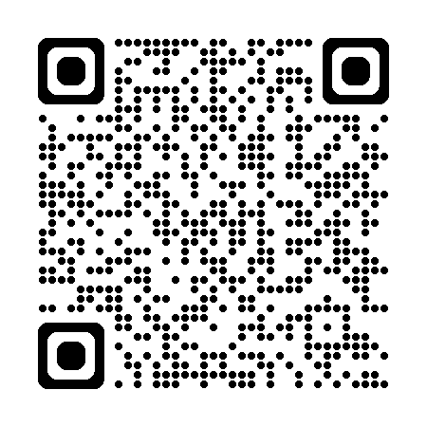
Contacts
Med Ed GP Fellowship iain.jamieson@aapct.scot.nhs.uk
Health Inequality GP fellowship iain.jamieson@aapct.scot.nhs.uk
Scottish Rural GP Fellowship Debbie.miller@nhs.scot
Lots of information on Deanery website

