Slide 1
SOAR Guidance for
Programme Directors (PD) - to make suggested Outcome to support Revalidation
Last updated: November 2018

Slide 2
Overview
Background
Login to correct Role on SOAR
Support
Process Overview
How to Sign off a Declaration
Review Declaration to make suggested Outcome to support Revalidation

Slide 3
Background (1/3)
SOAR is for all trainees in a training programme, including LATs and Foundation doctors
Trainee data from Turas is imported nightly to SOAR (around 1am), including:
  Trainee details and their ARCP outcomes if applicable
  Trainees’ linked Educational Supervisor (EdSup)
  Programme Directors (PD = TPDs/FPDs)
EdSups are linked to Trainees on SOAR automatically from imported data (provided that the EdSup is already on SOAR - checked against GMC number)
  If not, SysAdmin receives email alert for investigation

Slide 4
Background (2/3)
As part of the Annual ARCP process, Training Programme Management (TPM) teams initiate a declaration on SOAR approximately 8 weeks prior to the ARCP date
Trainees are asked to login to SOAR to complete their self declarations on Health, Probity, Complaints and Work History
EdSups linked to a Trainee are asked (via system automated emails) to sign off their Trainees’ declarations
  Automated reminder emails are also sent

Slide 5
Background (3/3)
Where required, PDs can sign off a Trainee’s Annual Declarations in lieu of the EdSup (but not usually)
  Please liaise with the relevant programme team administrator, as appropriate
Annually, PDs are asked to review their Trainees’:
  Signed off declarations
  ARCP outcomes; and
  Make suggested Outcome to support Revalidation

Slide 6
Supporting Revalidation
PDs are NOT asked to revalidate trainees, only review the information available and make suggested outcome to support their Trainees’ Revalidation
Only the Responsible Officer (RO) and the nominated ROs are tasked with revalidating the Trainees

Slide 7
TPM Administrator
Trainee
Ed Supervisor
TPD/FPD
PGDean / RO
Assign Educational Supervisor to Trainee
(on Turas)
Complete Declarations
Ed Sup signs off declaration; and notes any issues arisen in the declarations or the discussions
PD reviews Health / Probity / Complaints / Work History (HPCW) and ARCP outcome
Revalidation recommendation for all green / ready (batch)
@
Submit to
Ed Sup for review
Assign TPD/FPD to their Programme
on SOAR if applicable
Review outcomes of others (individual)
@
PD makes suggested Outcome to support Revalidation
Approximately 8 weeks prior to ARCP Initiate Declaration(s) either as a batch or individually) (Health/Probity/ Complaints/Work History (HPCW))
SOAR Overview:
Electronic processes to make suggested outcome to support Trainee Revalidation
Confirmation of Revalidation outcome
GMC Connect

Slide 8
How To – Sign off a Declaration

Slide 9
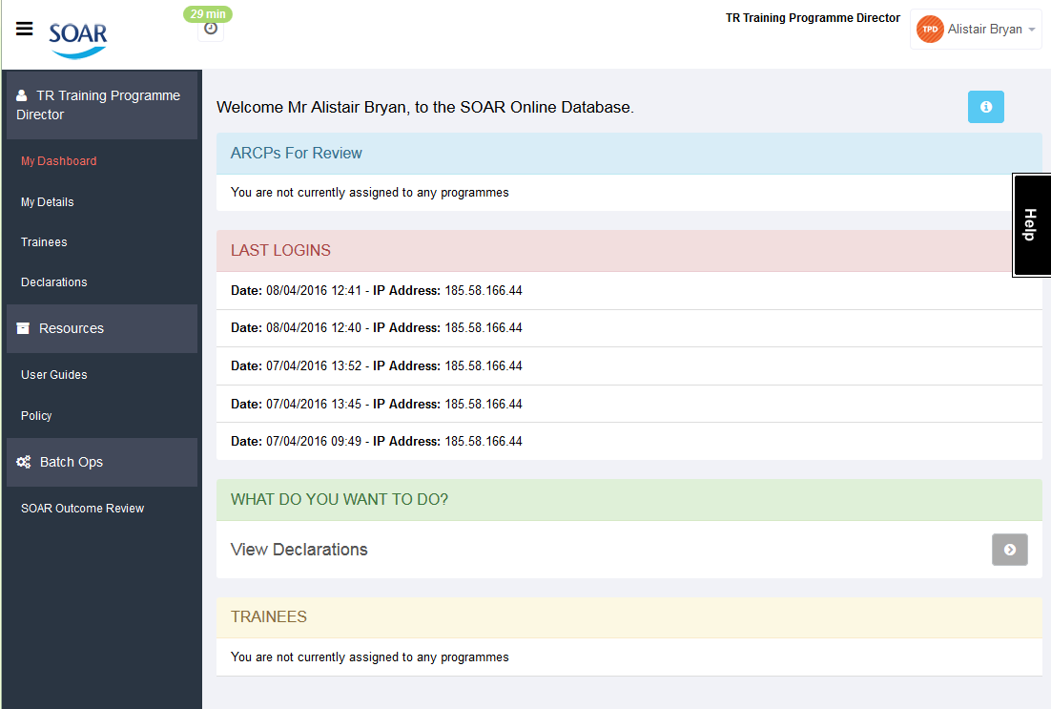
Login with your existing SOAR login
Change Role to “TR Training Programme Director”
“My Details” are the same as your appraisal details
“Trainees” lists all those in your programme
“Declarations” lists all those declarations involving your Trainees

Slide 10
“SOAR Outcome Review” allows you to make suggested outcome to support your trainees’ revalidation
You do not make revalidation recommendations, the Responsible Officer (RO) does, you are only asked for your suggestion, based on ARCP and self declarations and other information you have access to

Slide 11
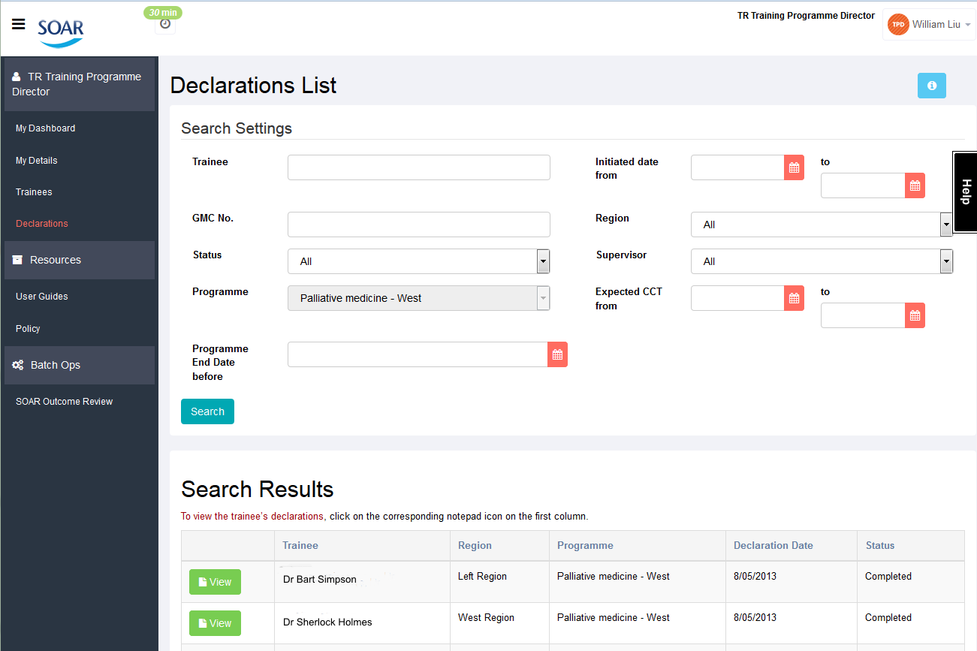
Click on Declarations
Details of the Declarations (Status; Region; date when Declaration was initiated)
Similar to Appraisals - click on the view icon to access individual Declaration details

Slide 12
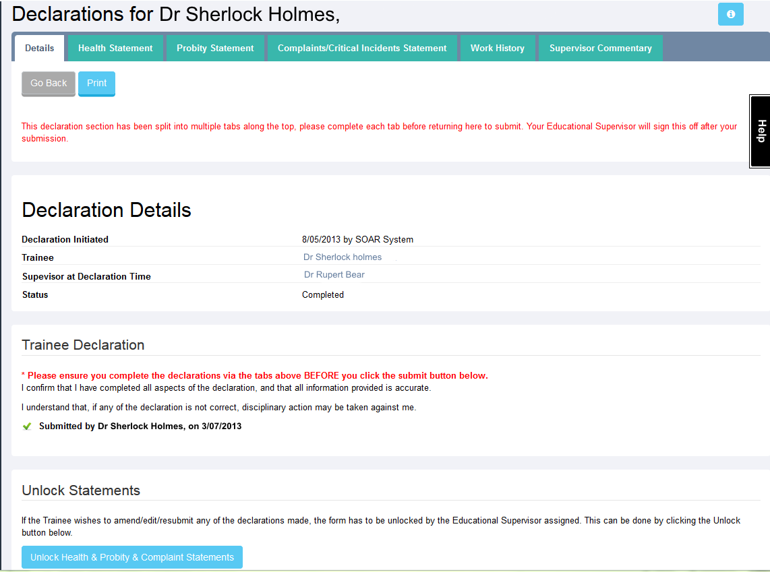
Self Declarations displayed as tabs for your review
General declarations details
Date of when Trainee submitted declarations
Sign off declaration and add any additional comments if required / appropriate

Slide 13
The sign off of trainees’ declarations is the EdSups’ responsibility
As PD, you can sign off the declarations in lieu of the EdSup but it is NOT as part of the norm
For trainees in Foundation it is the FPD who signs off a trainees declaration

Slide 14
Review Declarations to make suggested outcome to support Revalidation (1/2)
(by individual trainee)

Slide 15
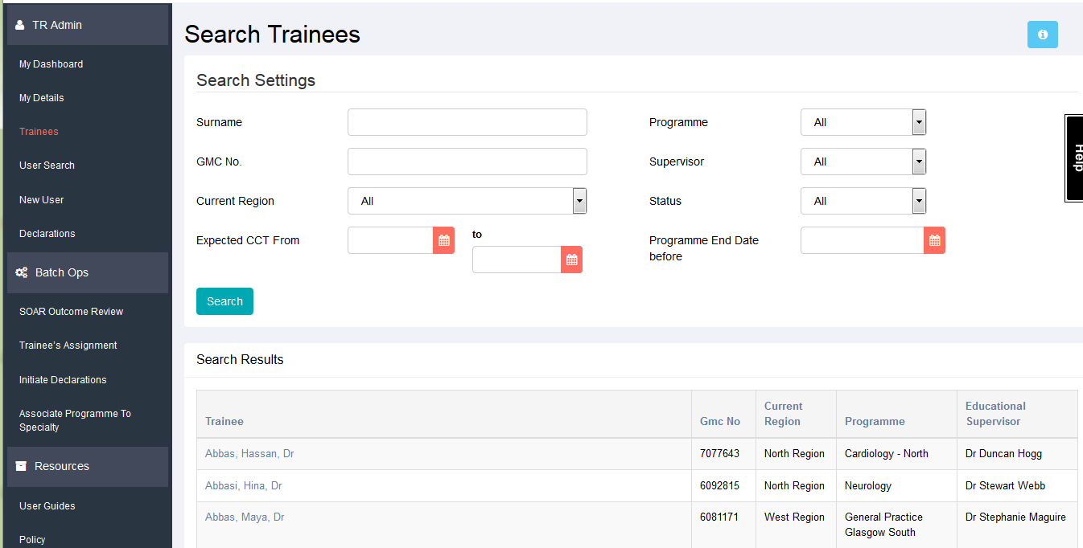
The Trainees page lists ALL trainees imported from Turas in your programme
Search by Surname or GMC number
Can also filter search by programme, region or supervisor
Can sort results by column heading
PDs only have access to their programmes’ Trainees
Click on Name to review trainee’s data

Slide 16
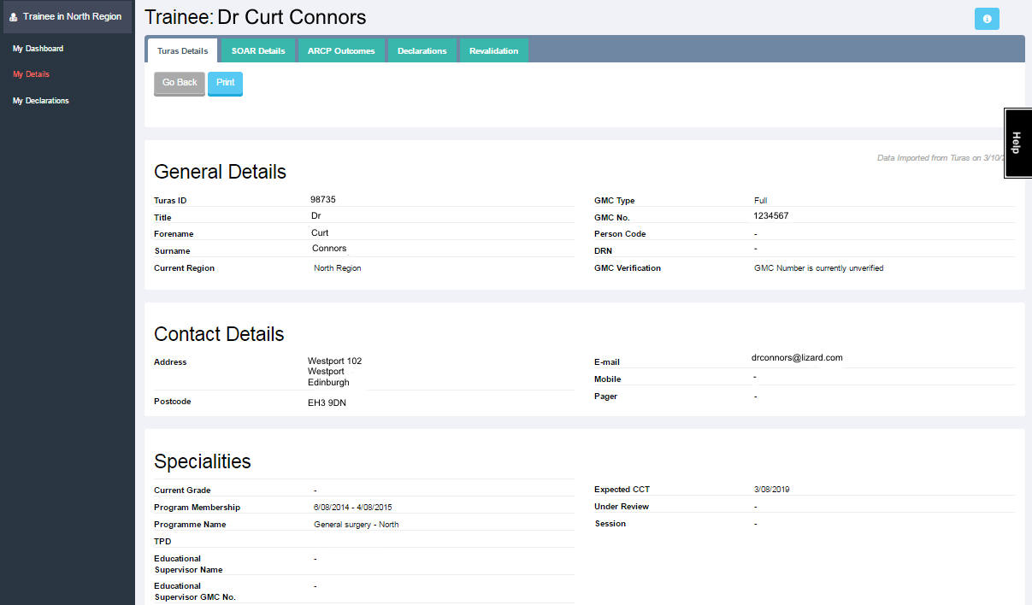
Turas data imported nightly
If information is not accurate, Trainees are asked to contact the SOAR team
SOAR Details = Login details (ignore)
ARCP Outcomes - imported from Turas

Slide 17
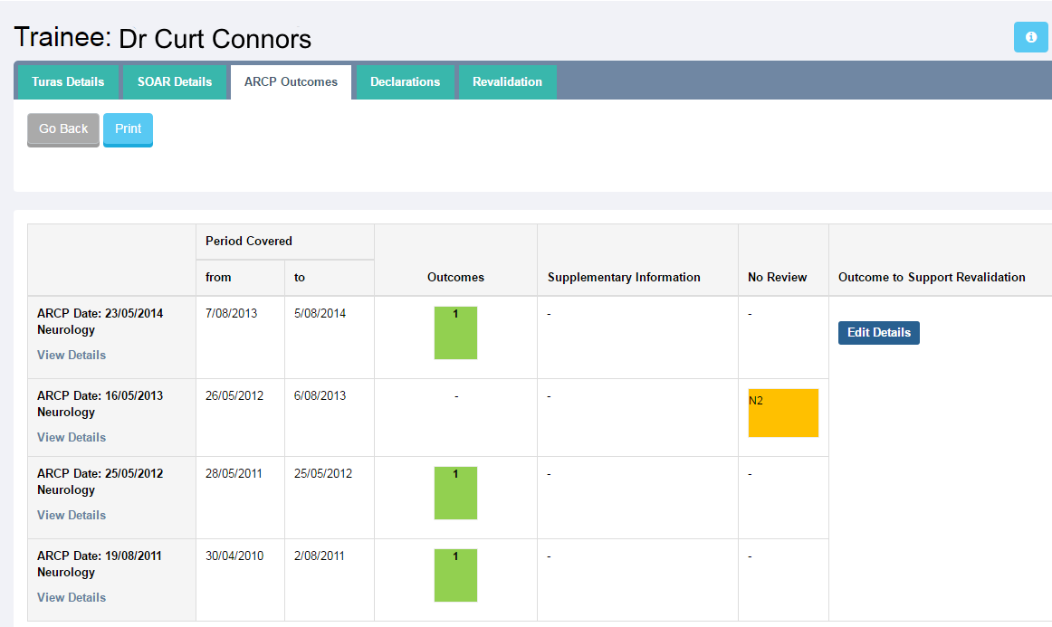
ARCP outcome imported from Turas
Click on “Edit / View Details” to add individual suggested outcomes
“Outcome to Support Revalidation”
  Marked by TPD
  Reviewed by Lead Dean Director (LDD)

Slide 18
Review Declarations to make suggested outcome to support Revalidation - review ARCP (2/2)
(by list/batch i.e. by programme)

Slide 19
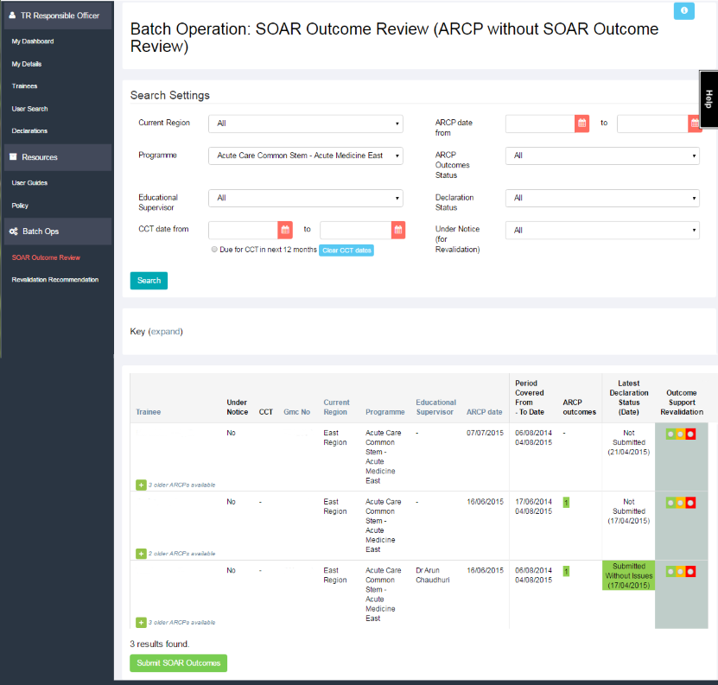
Click “SOAR Outcome Review”
Only Trainees in your programme will be listed
By default, this page will always bring up those due for CCT in the next 12 months
Amend search settings as required

Slide 20
View latest ARCP outcome and Declarations status at a glance
Select suggested outcome to support Revalidation - if you are unsure on the Red/Amber/Green keys, expand keys for more information
Click “Submit SOAR Outcomes” button at bottom of page

Slide 21
Further support
Medical Appraisal Scotland website:
  www.appraisal.nes.scot.nhs.uk
  Resources, FAQ and other useful sections
Local Administration teams:
  Contact details on Medical Appraisal Scotland website (Contacts > Deaneries)
SOAR Helpdesk
  “Help” box / form when logged into SOAR;
  or SOAR@nes.scot.nhs.uk
Due to capacity issues we are unable to offer telephone support
  You can request a call back via the Helpdesk – but we need detailed descriptions of the issue(s)

