Slide 1
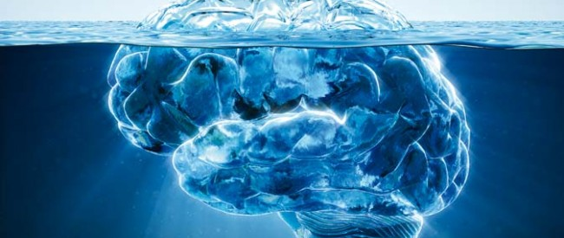
Fair Appraisal
The Role of Unconscious Bias

Slide 2
Outline
What is unconscious bias (or implicit association)?
Types of bias
Relevance to appraisal
Identifying and managing bias

Slide 3
Principles for respectful inquiry
Listen to understand​
Honour confidentiality​
Be mindful of the impact of what we say​
Assume good intention in others​
Give and receive caring feedback​
Be curious about emotional responses

Slide 4
What makes a good doctor?
In your groups, use the outline to illustrate a ‘good doctor’. You may add text explanations or other elements to the picture.
You have no more than 10 minutes – so work fast.
Notes:
At conclusion, reflect on what they illustrated.
What kind of person is this?
Where did you get the idea for this sort of person?
How is this person like you? Not like you? Like people you know?
What does this tell you about your assumptions about professional identity?
Is this a model which might influence the way you approach appraisal?

Slide 5
How objective are we?
Moss-Racusin et al (2012) had staff in science faculties in US colleges rate the application of a student for a position as a laboratory manager.
The same application was used 127 times and randomly assigned either a female (64 times) or male (63 times) name.
Selectors rated the male applicant as significantly more hireable than the female applicant. They also chose a higher starting salary and offered more career mentoring to the male applicant.
The gender of the selector did not affect responses.
Moss-Racusin, CA, Dovidio, JF, Brescoll, VL, Graham, M & Handelsman, J (2012) ‘Science faculty’s subtle gender biases- favour male students’. Proceedings of the National Academy of Sciences for the United States of America 109(41): 16474-16479

Slide 6
A recent research report looking at the experiences of BAME staff within the Civil Service showed that in Performance Management Review BAME people were underrepresented in those considered to be “succeeding” in their objectives and overrepresented among those merely “achieving” or who “must improve”.
BAME staff are winning a smaller number of promotions at Senior Civil Service level now than in 2010 and the overall proportion of promotions going to BAME staff has fallen.
Ethnic Dimensions (2014) ‘Identifying and Removing Barriers to Talented BAME Staff Progression in the Civil Service’.
Notes:
These are two examples of recent studies which highlight the limits of our objectivity in processes like selection and appraisal. There are numerous others. What’s going on here?

Slide 7
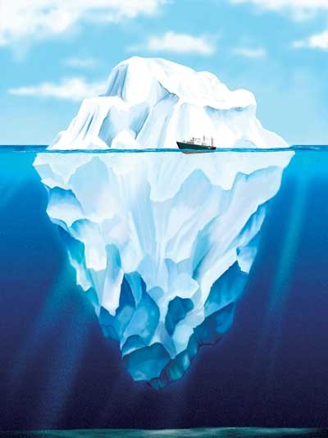
The black box of your brain…..
Cultural symbols & stereotypes
Social / structural factors
Cognitive categories
Notes:
Unconscious bias refers to a bias that we are unaware of, which happens outside of our control. It is a bias that happens automatically and is triggered by our brain making quick judgments and assessments of people and situations, influenced by our background, cultural environment and personal experiences. Some researchers will used the term ‘implicit association’. This is because, cognitively, what is happening is that the mind is automatically making associations between particular things, characteristics or people below the level of your attention, and these can be brought into some level of attention with effort.
(ECU: 2013 Unconscious bias in higher education)
Talk through influences on our thoughts and actions. Refer to the structural inequalities in the labour market we discussed earlier as part of the discussion. Highlight that influences may be below or above the line of ‘consciousness’ and that we can attend to them to move them up into our conscious thinking and thus manage our responses. Some things are harder to bring to the surface than others – some because they are psychologically challenging, but some because they are so taken for granted by us and those around us that they are just very, very hard to see. Where cultural assumptions are shared and there isn’t much diversity this is a particular problem – if you consider the outline of this iceberg and think of a mold around the edges, that mold will be almost impossible to see as long as it fits the iceberg exactly. If the light changes, or the ice melts a bit, or someone dumps some dye on the ice that only affects ice – or only affects the material of the mold, you can see it. That’s the sort of thing that happens in situations where we have things like cultural contact, or when social change is happening, or when our day to day practice no longer fits older cultural stereotypes, symbols or expectations – you can get a bit of space where you see that the mold and the contents don’t quite fit. This opens up possibilities but is often also quite disconcerting, and it’s a common experience in change situations. You can, essentially, remold the iceberg. Metaphorically, this is true for your thinking, and it’s also true for organisational cultures. In both cases, it takes attention and work.
Return to examples above – impact of images of ‘scientist’ or ‘civil servant’, and also how structural privileges – access to networks, information, etc – can impact on those outcomes. Relate to this diagramme.

Slide 8
Unconscious Bias/Implicit Association
Bias we are unaware of – tends to happen outside our control
Based on automatic judgements or assessments of people or situations
Influenced by our background, environment, personal experiences
We can be made aware of these biases and act to control them.

Slide 9
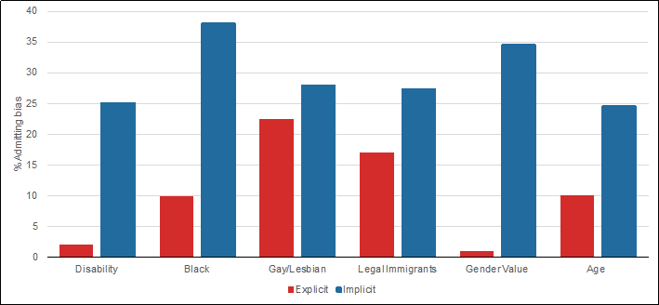
The difference between explicit and implicit bias
Notes:
In this chart the red columns represent the biases people will confidentially admit to. Almost no one will admit to having a prejudice against disabled people or women. However when unconscious biases are measured (the blue columns) nearly 40% of people have unconscious biases against particular genders and black people, This massive discrepancy between our conscious and unconscious biases is the opportunity we have to improve our people decisions, and lever the advantages of talent for the benefit of our organisations. (Research by Abrams D & Houston D 2006)
Issues:
Social desirability
Management of bias
Some biases harder to see/recognise
Also note – these are older stats, so very likely to have changed post-Brexit.

Slide 10
Types of bias
Affinity (these people are like me. Basis for in-groups.)
Confirmation (what I already thought)
Attribution (we tend to differential attribution for our in-groups and out-groups)
Stereotype (eg, white males are often seen as leaders, women often thought of as ‘better at communication’)
Group Think (minimise conflict - agree with the group)
Halo Effect (good in one area – good in all areas?)
Salience (previous performance continues to affect view)
Micro-aggressions (behavioural manifestations of bias)
Notes:
Discuss each type briefly. Then ask them to consider:
Provide an example of each of these, either ones they’ve observed or theoretical ones.
How could each of these types of bias impact on appraisal. Also think about impacts on career progression and development, and on the various people who might be involved in the appraisal process.
Suggest they think back to the ‘good doctor’ they drew in the first exercise.
At end, take some feedback on key points, questions. The following slides can summarise areas of risk.

Slide 11
Scope for bias – management and development
Workplace culture (‘fitting in’, informal support)
Feedback & Performance Support
Development & learning opportunities
Work allocation
Coaching & mentoring
Notes:
How did these link to your discussion of assessment processes? Will bias in these areas be likely to show in assessments? How do they relate to assessment processes themselves?

Slide 12
Scope for bias -- appraisal
Who gives feedback?
Whose feedback matters?
Stereotypes – professional identity
Stereotype threats – self limitation
Microaggressions
Honesty/usefulness/ timeliness

Slide 13
Recognising and reflecting on bias
Implicit association tests
Encounter diaries
Reflective practice
‘Reverse mentoring’
Awareness of resilience & emotional intelligence
Notes:
These are some of the techniques used to identify and manage bias. Handouts with further information on IATs and encounter diaries are will be sent out with the slides. NES’s management development network has good learning resources on areas like managing with emotional intelligence. You can find these online via the Knowledge Network.

Slide 14
What can we do about unconscious bias?
Accept we are all biased​
Challenge stereotypes and use counter-stereotypical information​
Change perception and relationship with out-group members​
Consider and try actively to manage micro-behaviours.​
Be an active bystander​
Manage emotional and cognitive load.​

Slide 15
And in appraisal --
Approach task with active intention to be fair and unbiased – but be self-aware and open to challenge.
Cross check sources and types of information, and consider if processes (affinity, confirmation, stereotyping) may affect that information.
Use the process – but do so thoughtfully.
Be an active bystander. If something looks wrong, say something.
Notes:
Interventions in experiments showed that when people primed themselves by activities or statements expressing a commitment to fairness, they were more likely to act fairly.This isn't foolproof, and be aware that experimental conditions are not the real world – in particular, they are not usually conducted with people who know each other and have ongoing relationships, power, hierarchies.
Think about how bias or prejudice might impact on the information that is there and the information that is not. This could impact on the existence of information, how the information is expressed, and also on how information is interpreted – whether by you or by other actors in this process. Studies show that affinity and confirmation bias in particular are real risks in assessment processes. We have an idea of what good looks like and are more apt to see things that confirm what we believe. When we think people who conform to our internal image of a 'doctor' or a 'manager' or whatever do well in a role,we tend to attribute this to their talent. When they do badly we tend to attribute it to external factors. With a counterstereotypical person we tend to do exactly the opposite.We are more critical of some people than others, and affinities can affect how we give feedback.
Use the process -- but unlike 'the Force' it's not infallible. People in a process can break it. Quite a lot of thought goes into these processes to make them tend towards fairness, and they will guide you in that direction. Check yourself against the process. But do so thoughtfully, bearing in mind the things we've discussed today. You are not a robot, and your judgement will be important.
Finally, if something looks wrong, it probably is. More importantly, you may be in a more powerful position than the person who is on the receiving end of the injustice.

Slide 16
End of presentation

